Slide 1

Introduction to Z-Tree
Chung-Ching Tai
Tunghai University, Taiwan

Slide 2
Outline
What is Z-Tree?
Designing an Experiment
Conducting an Experiment
Data Files
Support

Slide 3
What is Z-Tree?
Zurich Toolbox for Ready-made Economic Experiments
Urs Fischbacher
Fischbacher, U. (2007), z-Tree: Zurich toolbox for ready-made economic experiments. Experimental Economics 10(2), pp. 171-178.

Slide 4
How to Get Z-Tree?
It is free!
  Download a license contract.
  Print two copies and sign them, fill in your postal and email addresses.
  Send contracts to
  Sally Gschwend,
  Institute for Empirical Research in Economics,
  University of Zurich,
  Bluemlisalpstrasse 10, CH-8006 Zurich.

Slide 5
How to Get Z-Tree?
  You’ll receive one copy of contracts and an email of login name and password for downloading z-Tree.
Sign the license on behalf of your institute or faculty so that people in your institute (ex: your assistants or students) can also run z-tree.
Refer to Fischbacher (2007) in your paper (if there is any…)

Slide 6
Requirements
Skills
  Programming experience is not necessary, but helpful
Hardware
  Very low requirements
OS
  Windows – NT, 2000, XP, (95, 98, ME)
  Unix – Wine
  Macintosh – Virtual-PC

Slide 7


A Client-Server Architecture
zleaf.exe (Client: Subject)
ztree.exe
(Server)

Slide 8
New Features
Displaying pictures and multimedia files
Graphical representation of data (interactive!)
  Game trees
  Pie charts
  Price paths
  Network links
  Visualization of market structure
Chat Function

Slide 9
New Features
Compatible with neuroeconomic experiments
  Timing of screen changes/user inputs can be precisely recorded
  External hardware input—such as fMRI scanner signals

Slide 10
Designing an Experiment
An example: public good game
Starting z-Tree
Specifying parameters
Programs
Input and output
Group Matching
Save your experimental design as a ztt file!

Slide 11
Public Good Game
Subjects are matched into groups.
Each subject has 20 dollars.
Each subject has to decide how much of his/her 20 dollars to contribute to the public account.

Slide 12
Public Good Game
The money in the public account will be multiplied by 1.6 and distributed among all subjects in the group.
The profit of each subject is the sum of his/her retained endowment and the money gained from the public account.

Slide 13
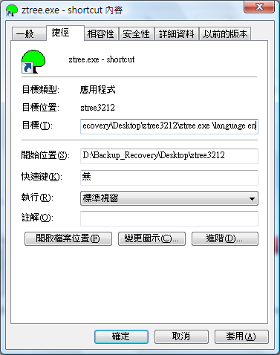
Preparation
Making a shortcut for
z-tree.exe
Specify the language
  Right-click the shortcut
  Choose “Properties”
  Add the parameter
  “/language en” (English)

Slide 14
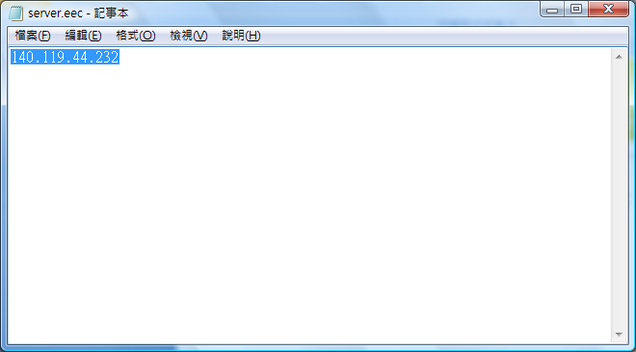
Specify Server IP
Specify the IP address in server.eec

Slide 15
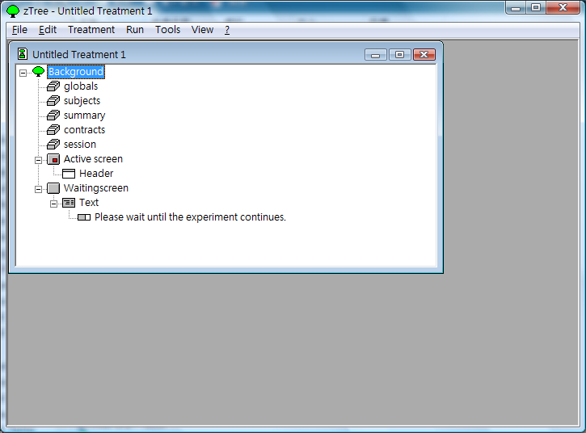
Starting z-tree (via the shortcut)

Slide 16
Specifying Parameters
Experiment
  Session
    Treatment
      Period
        Stage

Slide 17
The Structure of the Experiments
How does z-Tree execute the commands?
Background
Tables
Stage 1
Programs
Stage 2
Programs
Active Screen
Waiting Screen
Active Screen
Waiting Screen
…

Slide 18
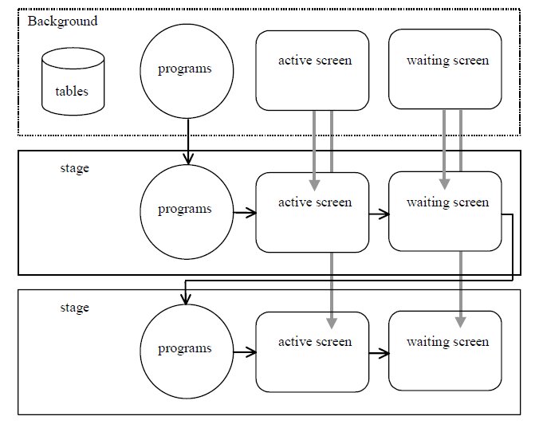

Slide 19
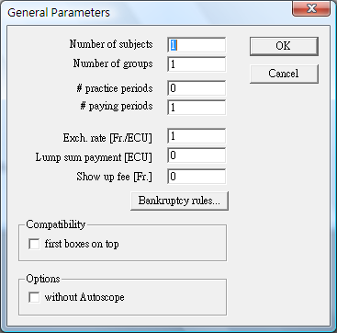
Background Parameters
Double-click Background
We will talk about
how to group subjects
later.

Slide 20
Tables
global, subject, summary, contracts, session
→ contains variables used in the experiment
Ex: some built-in variables
  Global: Period, NumPeriods
  Subject: Period, Subject, Group, Profit, TotalProfit, Participate

Slide 21
How to Create Variables
you can create your own variables in the programs

Slide 22
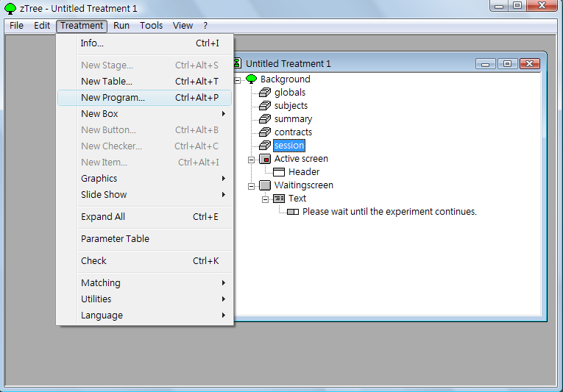
Programs
To add programs,
  Select the last item (the item before the program)
  “Treatment” menu
  → “New Program”

Slide 23
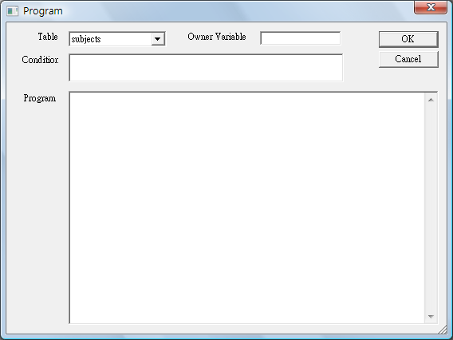
Programs
Specify the table
Declare and assign values to variables
Do the programming
(use semicolon to separate expressions)

Slide 24
Programs
Some useful operators
  +, -, *, /
  <, <=, ==, !=, >=, >
  &, |
Scope operators
You can look up functions in the Reference Manual.

Slide 25
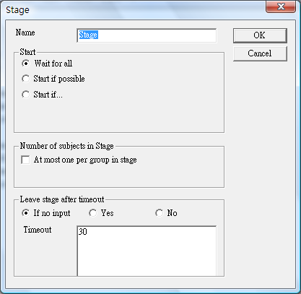
Add a new stage:
  Select Background
  “Treatment” menu
  → “New Stage”

Slide 26
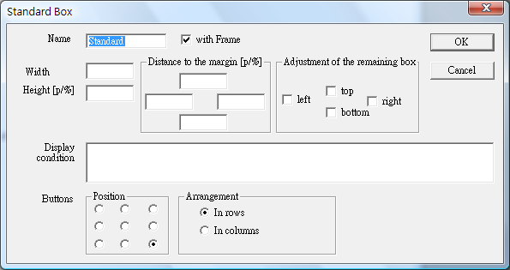
Input and Output
Active Screen & Waiting Screen
Add a new box:
  Choose “Active Screen” of the new stage
  “Treatment” menu → “New Box” → “Standard Box”

Slide 27
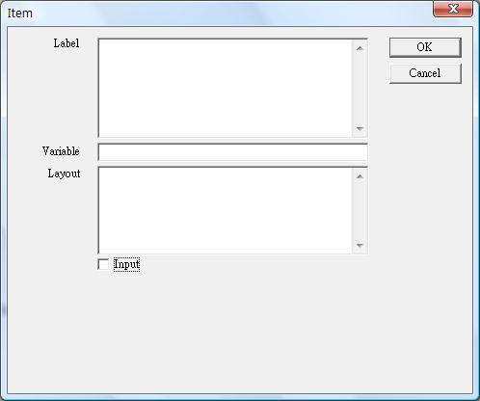
Item
Item:
  input item
  output item
Add an item:
  Select a box
  “Treatment” menu
  → “New Item”
The value will be shown as a multiple of the value specified in the “Layout” field
Check “Input” if you are going to create an input field

Slide 28
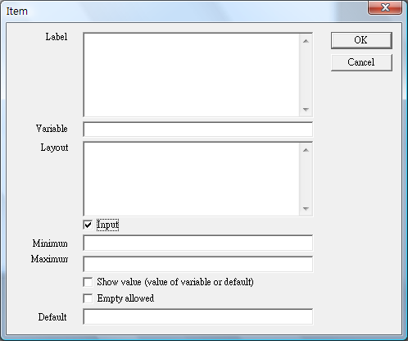
An input item

Slide 29
Group Matching - Programs
You can do the group matching by writing your own programs in the subjects table,
ex:
Group = if(mod(Subject,5)>0, rounddown(Subject/5,1)-1, rounddown(Subject/5,1));

Slide 30
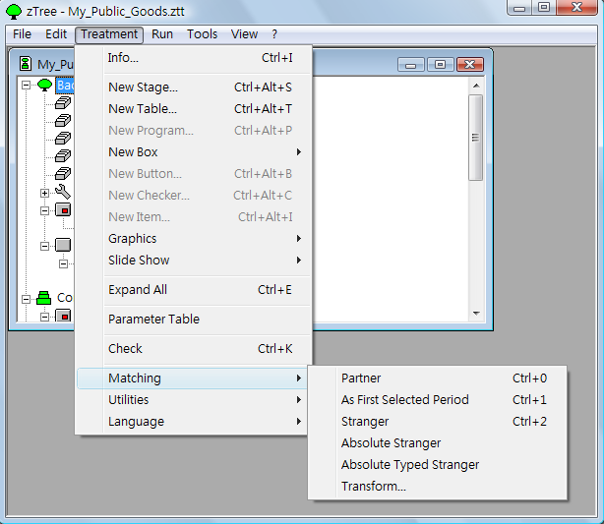
Group Matching – Automatic
Or you can let z-Tree do it automatically.

Slide 31
Some Useful Options
Partner:
The first players constitute group 1, the next players group 2 and so on.
Stranger:
Random matching for each period.
Absolute Stranger:
each subject is never in the same group with others more than once

Slide 32
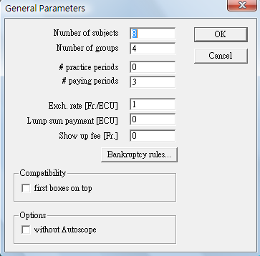
Group Matching – Parameter Table
Specify group identities directly in the parameter table.
Ex: an experiment with
8 subjects, 4 groups, 3 periods

Slide 33
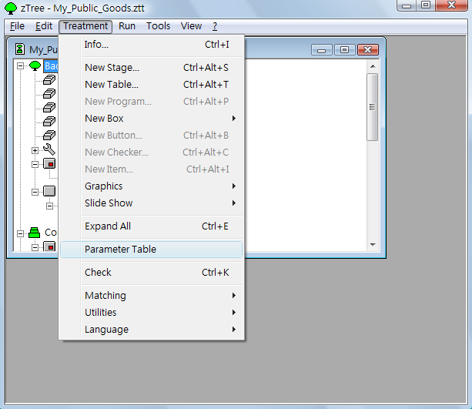
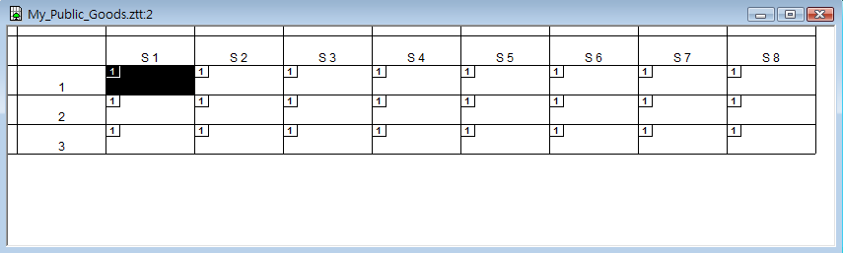
“Treatment” menu → Parameter Table

Slide 34
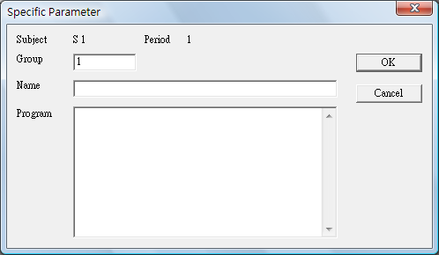
Double-clicking the cells brings out the parameter windows

Slide 35
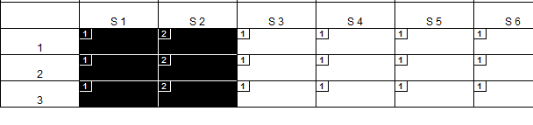
You can copy and paste parameter settings by
  Specify the group parameters in some cells
  Select these cells
  Copy to other cells by dragging the selected cells

Slide 36
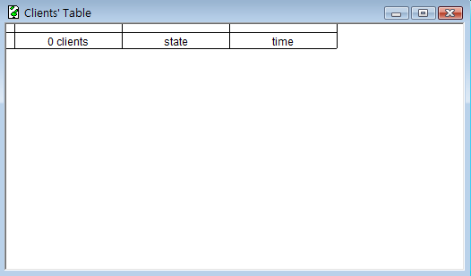
Conducting an Experiment
You can use Clients’ Table to monitor what subjects do.
“Run” menu → “Clients’ Table”

Slide 37
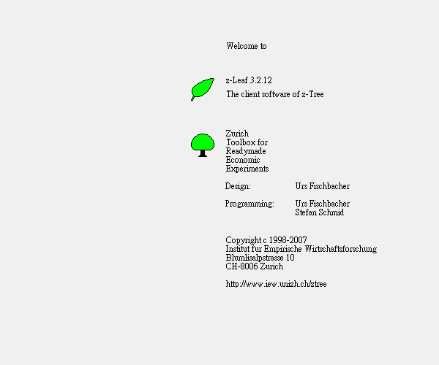
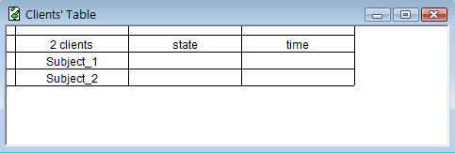
Welcome Screen – z-leaf
You can see the subjects if they execute z-leafs and connect to z-Tree successfully.
Clients’ Table – z-Tree
Welcome Screen – z-leaf

Slide 38
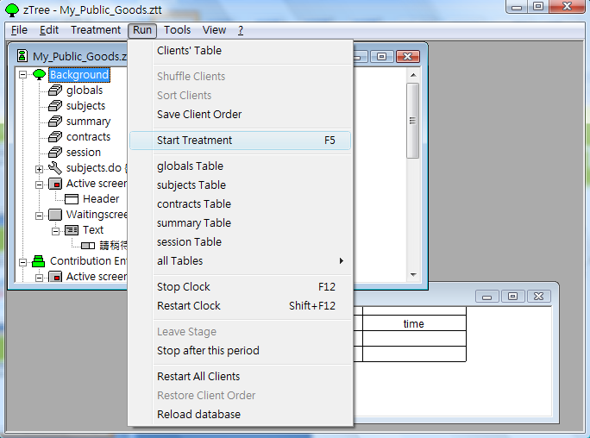
Start the Treatment
Select the ztt window
“Run” menu → “Start Treatment”

Slide 39
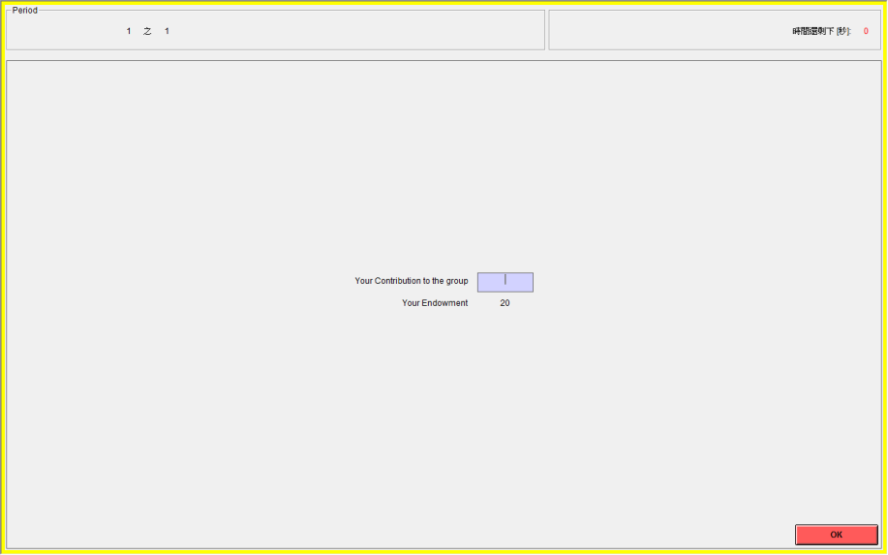
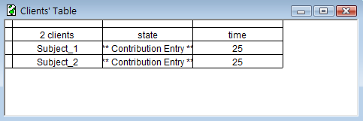
Once the treatment is started, you can observe subjects’ progress in the Clients’ Table.

Slide 40
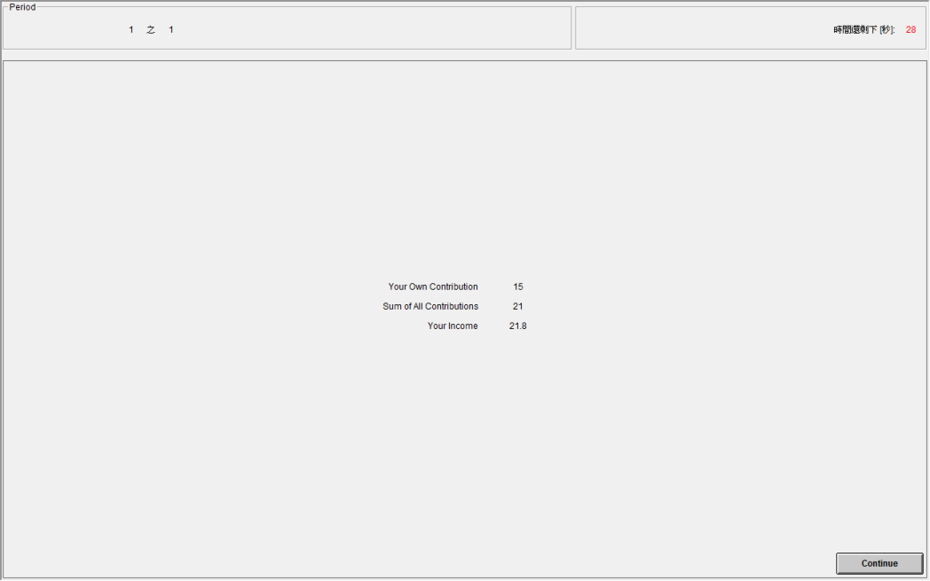
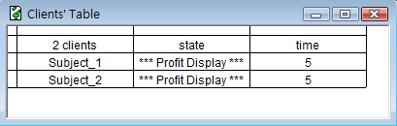
Displaying profit Information

Slide 41
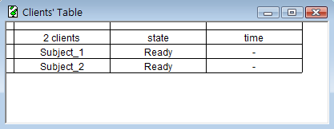
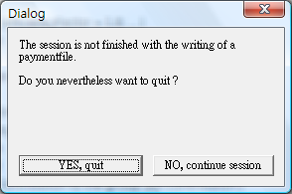
To End the Experiment
Make sure every subject has finished their jobs.
Clients (z-leaf) –
Alt + F4
Server (z-tree) –
“File” menu → “Quit”

Slide 42
Data Files
Files created by z-Tree:
  xls file – the main data file
  sbj file – questionnaire responses
  pay file – payment file
  adr file – subjects’ address
  gsf file – gamesafe in binary form
All tables are saved here!

Slide 43
Support
Official Website
http://www.iew.uzh.ch/ztree/index.php
Z-Tree Wiki
https://www.uzh.ch/iew/ztree/ssl-dir/wiki/
Mailing list
https://lists.uzh.ch/iew.lists.uzh.ch/sympa/info/ztree (hit “subscribe” in the left)

