Slide 1
Bottom-Up Coordination in the
El Farol Game: an agent-based model
Shu-Heng Chen, Umberto Gostoli

Slide 2
The El Farol Bar Problem (Arthur, 1994)
N people decide independently each week whether to go to a bar (El Farol bar, in Santa Fe). In the Arthur’s paper N is set at 100.
Space in the bar is limited and the evening is enjoyable only if no more than 60 people are present.
There is no way to tell the numbers coming for sure in advance. Therefore a person goes if he expects fewer than 60 people to show up, or stays home if he expects more than 60 people to go.
An interesting feature is that any commonalty of expectations gets broken up: if all believe few will go, all will go. But this would invalidate that belief. Similarly, if all believe most will go, nobody will go, invalidating that belief. Expectations will be forced to differ.
Many of subsequent papers on the El Farol bar problem, while considering different learning mechanisms, keep the population size to 100 and the threshold to 0.6. So, do we in the present work.

Slide 3
From the positive to the normative approach to El Farol Bar Problem (I).
The El Farol Bar Problem has been extensively analyzed following the structure introduced by Arthur (1994).
The learning mechanism proposed by the literature go from the best-reply learning, (as in the Arthur’s seminal paper), to reinforcement learning, where the probability each customer has of going or not going to the bar depends on the relative payoff of the two actions.
With the first mechanism, the attendance fluctuates around the threshold as the agents keep revising their forecasting models.
With the second mechanism the system can reach an asymmetric equilibrium where 60% of agents always go and 40% never go when the agents do not know the bar’s attendance when they do not go to the bar.
It is clear, by know, that given the original framework, the system cannot reach a symmetric equilibrium, where all the agents go to the bar 60% of the time (on average, over a given number of periods) and the bar in never too crowded.

Slide 4
From the positive to the normative approach to El Farol Bar Problem (II).
In the present work, we will try to approach the problem from a normative point of view, asking the following question: “Which are the minimal conditions allowing the system to reach the symmetric equilibrium?”. In other words, can the ‘invisible hand’ solve the El Farol bar problem and, if yes, under which conditions?
If the agents take their decisions on the basis of global information (general attendance) , too little or too many of them are likely to show up at the bar: they cannot effectively coordinate.
If they base their decision only on their private information (their payoff) coordination may be achieved but at the price of inequality: some of the agents will always go whereas some others will always stay at home.
In order to reach a symmetric equilibrium, the agents need to use some external information, however, to avoid herding, they should not use all the same information.
The only way the agents can coordinate is by using local information, that is, looking at their neighbors’ attendance. So, we need to change the original El Farol bar problem structure by introducing social networks.

Slide 5
The Agent-Based Model:
Neighborhood and Strategy
100 agents are arranged on a circle. Each of them gets the previous decisions of his neighbors: the two neighbors on its right side and the two neighbors on its left side, as shown below.
A strategy (an example of which is shown below), specifies an action, Going (1) or Not Going (0), for every possible situation (its neighbors’ choices) the agent witnessed in the past period. With 4 neighbors, the strategy is a 16-bit long binary string.
Neighbor 1 | Neighbor 2 | Agent | Neighbor 3 | Neighbor 4
Input | Action | Input | Action | Input | Action | Input | Action
0-0-0-0 | 0 | 0-1-0-0 | 1 | 1-0-0-0 | 0 | 1-1-0-0 | 1
0-0-0-1 | 1 | 0-1-0-1 | 1 | 1-0-0-1 | 1 | 1-1-0-1 | 1
0-0-1-0 | 1 | 0-1-1-0 | 0 | 1-0-1-0 | 1 | 1-1-1-0 | 0
0-0-1-1 | 1 | 0-1-1-1 | 0 | 1-0-1-1 | 1 | 1-1-1-1 | 0

Slide 6

The Agent-Based Model:
Learning and Fitness Function
With a certain probability p, each agent revises its strategy by imitating (with mutation) the strategy of their most successful neighbor.
The strategy fitness function F is given by the following equation:
With a memory of a specified size M, the Forecasting Performance is the frequency of correct forecasts, that is, when the agent chose to go and the bar was not crowded or when he chose to stay at home and the bar was too crowded.
The denominator is the smaller (and the fitness is the higher) the closer is the agent’s average attendance (over its memory M) to 0.6. This implies that the agents’ preferences depend on the equality of the average attendances among the population of agents. The absolute value of the difference is increased by 1 to avoid a division by 0.
The strategy fitness value F can go from 0 to 1.
The probability p of each single bit of the strategy being mutated after being copied, is a parameter of the model.

Slide 7
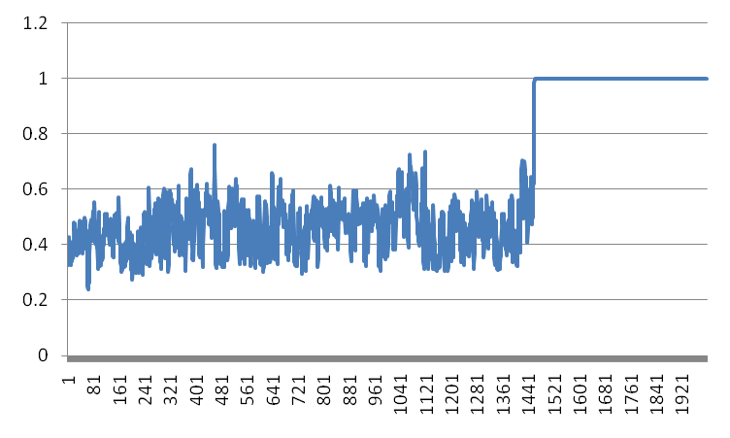
Simulation Results: the Average Strategy Fitness
In this run, the average strategy fitness, does not improve until around period 14000, when it suddenly ‘jumps’ to 1 and remains there: the socially optimal equilibrium has been reached. Although the period at which the system reaches the equilibrium changes from run to run, the general dynamics remains the same.

Slide 8
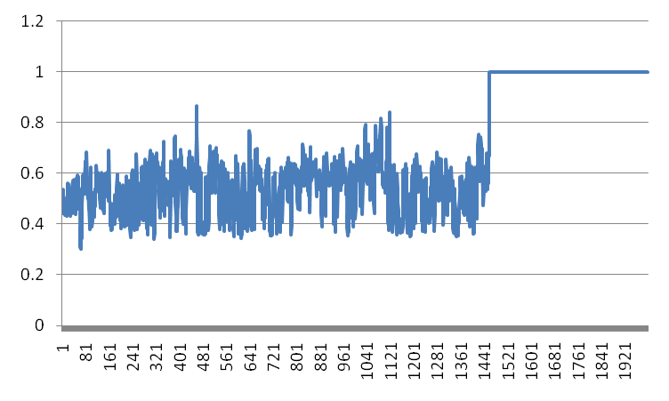
Simulation Results: the Average Forecasting Performance
The average forecasting performance follows quite closely the average strategy fitness.

Slide 9
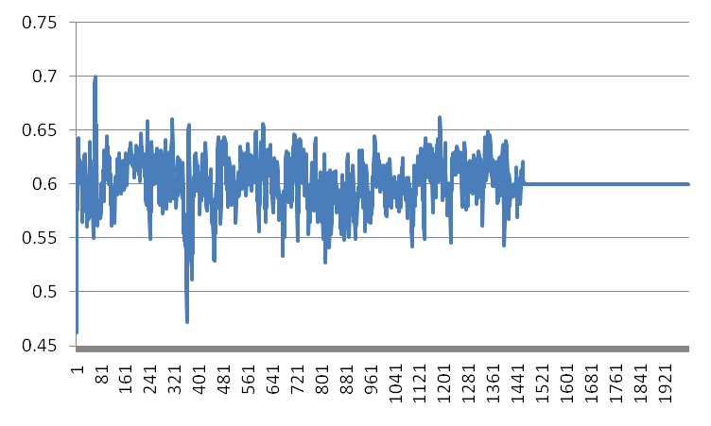
Simulation Results: the Average Attendance
The average attendance fluctuates around the threshold until it reaches the optimal level of 0.6.

Slide 10
Neighborhood attendances at the equilibrium (example)
N1 | N2 | Agent | N3 | N4
0 | 1 | 1 | 1 | 0
0 | 0 | 1 | 1 | 1
1 | 0 | 0 | 1 | 1
1 | 1 | 0 | 0 | 1
1 | 1 | 1 | 0 | 0
0 | 1 | 1 | 1 | 0
0 | 0 | 1 | 1 | 1
1 | 0 | 0 | 1 | 1
1 | 1 | 0 | 0 | 1
1 | 1 | 1 | 0 | 0
0 | 1 | 1 | 1 | 0
0 | 0 | 1 | 1 | 1
1 | 0 | 0 | 1 | 1
1 | 1 | 0 | 0 | 1
1 | 1 | 1 | 0 | 0
In every simulation, the system reaches an equilibrium where all the agents follow the 5-period cycle:
1-1-1-0-0

Slide 11
Strategies’ Types at the equilibrium
In all the simulations, the four strategies shown below emerge. Although a strategy specifies an action for every possible scenario, at the equilibrium only 5 scenarios appear: in particular Strategy 1 and Strategy 3 are characterized by the 5 scenarios highlighted in orange and Strategy 2 and Strategy 4 by the 5 scenarios highlighted in green.
Input | Strategy 1 | Strategy 2 | Strategy 3 | Strategy 4
0-0-0-0 | 1 | 1 | 0 | 0
0-0-0-1 | 1 | 1 | 1 | 1
0-0-1-0 | 0 | 1 | 1 | 1
0-0-1-1 | 0 | 0 | 1 | 1
0-1-0-0 | 1 | 0 | 1 | 1
0-1-0-1 | 1 | 1 | 1 | 0
0-1-1-0 | 0 | 1 | 1 | 1
0-1-1-1 | 1 | 0 | 1 | 1
1-0-0-0 | 0 | 1 | 0 | 1
1-0-0-1 | 1 | 0 | 0 | 0
1-0-1-0 | 0 | 1 | 0 | 1
1-0-1-1 | 1 | 0 | 0 | 1
1-1-0-0 | 1 | 1 | 0 | 0
1-1-0-1 | 1 | 1 | 0 | 0
1-1-1-0 | 0 | 1 | 1 | 0
1-1-1-1 | 1 | 0 | 1 | 0

Slide 12
Strategies’ Shortcuts
Another feature of the equilibrium is that once it has been reached, the agents do not need to look at all their neighbors anymore, to take the action prescribed by the strategy. For example, let’s look at Strategy 1.
Input | Strategy 1
0-0-0-0 | 1
0-0-0-1 | 1
0-0-1-0 | 0
0-0-1-1 | 0
0-1-0-0 | 1
0-1-0-1 | 1
0-1-1-0 | 0
0-1-1-1 | 1
1-0-0-0 | 0
1-0-0-1 | 1
1-0-1-0 | 0
1-0-1-1 | 1
1-1-0-0 | 1
1-1-0-1 | 1
1-1-1-0 | 0
1-1-1-1 | 1
We can notice that the action prescribed by the agents’ strategy in each of the 5 recurring situations characterizing this strategy, are equal to the last neighbor’s previous action (highlighted in red).
So, at the equilibrium, the agents can simply follow the rule “Do as your Neighbor 4 did in the last period”.
The same is true for the other three strategies, but for each of them the neighbor to look at is different: Neighbor 1 for Strategy 2, Neighbor 2 for Strategy 3 and Neighbor 3 for Strategy 4.

Slide 13
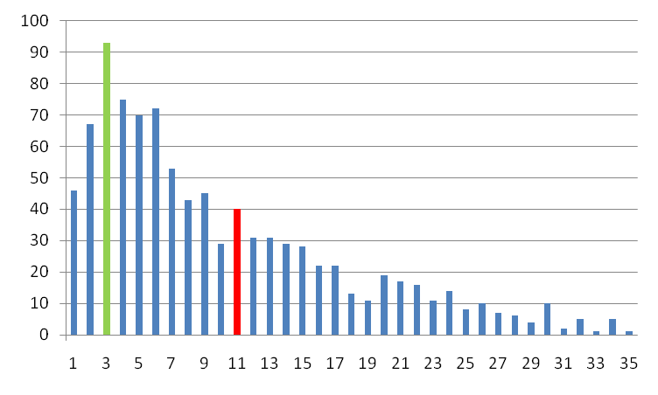
Time-to-Equilibrium Distribution
The distribution of the number of periods the system takes to reach the equilibrium is positively skewed. The mode (green bar) is around 5000 periods and the average (red bar) is around 22000 periods. However, over 1000 simulations, the system could take as many as 200000 periods to reach the equilibrium.

Slide 14
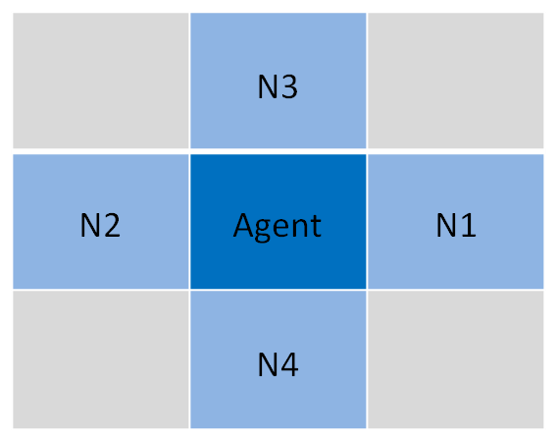
From the Circle Neighborhood to the von Neumann Neighborhood
So far, the agents were thought as being on a circle: they looked at their 2 closest neighbor to their left and the 2 closest neighbors to their right.
In this second set of simulations, the agents are thought as being placed on a grid covering the surface of a torus: their neighborhood is defined as the von Neumann neighborhood with r = 1.
In which way does the different network structure affect the path to the socially optimal equilibrium?

Slide 15
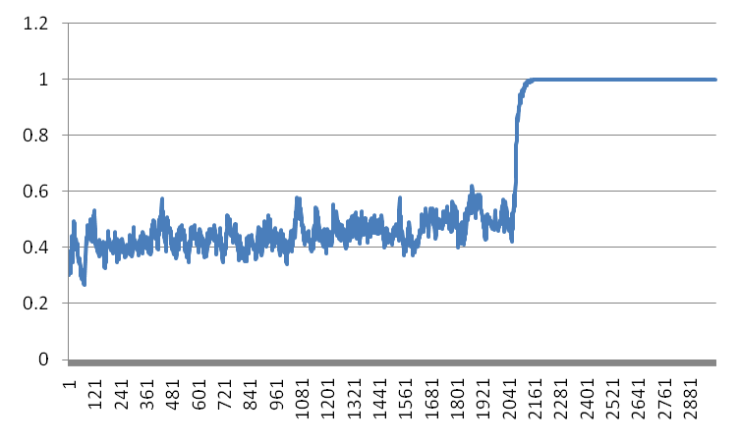
Von Neumann Neighborhood: the Average Strategy Fitness
In this run, the system reaches the equilibrium after about 2000 periods. Differently from the Circle Neighborhood, where the average fitness did not seem to improve much before the equilibrium, in this case there seems to be a positive trend before the ‘jump’.

Slide 16
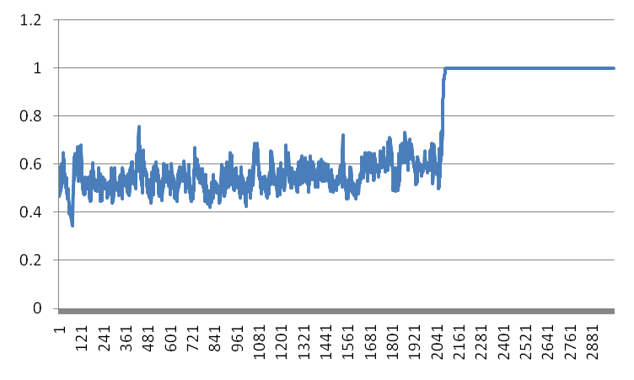
Von Neumann Neighborhood: the Average Forecasting Performance
Also in this case, the average forecasting performance follows quite closely the average strategy fitness.

Slide 17
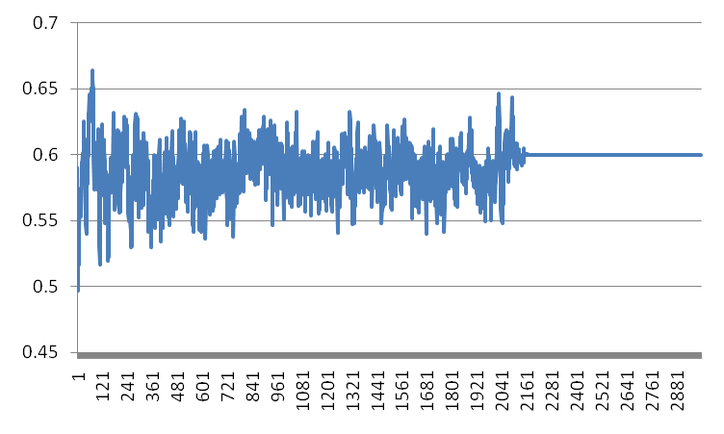
Von Neumann Neighborhood: the Average Attendance
The average attendance fluctuates around the threshold (but, on average, below the threshold) until it reaches the optimal level of 0.6.

Slide 18
Strategies’ Types at the equilibrium
Also in this case, four strategies emerge and also in this case, at the equilibrium, only few of the 16 possible situations actually occur. However, while with the Circle 5 rules were used, in this case only 3 rules (highlighted in green and orange) occur, depending on which of the four strategies emerges.
Input | Strategy 1 | Strategy 2 | Strategy 3 | Strategy 4
0-0-0-0 | 1 | 1 | 0 | 1
0-0-0-1 | 0 | 1 | 0 | 0
0-0-1-0 | 1 | 0 | 0 | 1
0-0-1-1 | 1 | 1 | 1 | 1
0-1-0-0 | 0 | 1 | 1 | 1
0-1-0-1 | 0 | 1 | 1 | 0
0-1-1-0 | 1 | 1 | 0 | 1
0-1-1-1 | 0 | 1 | 0 | 1
1-0-0-0 | 1 | 0 | 1 | 1
1-0-0-1 | 1 | 0 | 1 | 0
1-0-1-0 | 1 | 0 | 1 | 0
1-0-1-1 | 1 | 0 | 1 | 0
1-1-0-0 | 0 | 1 | 1 | 1
1-1-0-1 | 0 | 1 | 1 | 0
1-1-1-0 | 1 | 0 | 0 | 1
1-1-1-1 | 1 | 1 | 1 | 1

Slide 19
Strategies’ Shortcuts
Also in this case, once the equilibrium has been reached, the agents can look at one of their neighbor. However, in this case the agents can look not just at one, but at one of two neighbors. In particular the four strategies are equivalent to the following rules:
Strategy 1: Do as your Neighbor 1 or Neighbor 3 did in the last period.
Strategy 2: Do as your Neighbor 2 or Neighbor 4 did in the last period.
Strategy 3: Do as your Neighbor 1 or Neighbor 4 did in the last period.
Strategy 4: Do as your Neighbor 2 or Neighbor 3 did in the last period.
As can be seen looking at the von Neumann neighborhood below, in every strategy, the two neighbors the agent can equivalently look at are adjacent to each other.

Slide 20
Equilibria with the von Neumann
Neighborhood
With the von Neumann neighborhood, beside the 1-1-1-0-0 cycle that appeared with the Circle Neighborhood, two new 10-period cycles appear. The three cycles are shown below.
Cycle 1 | Cycle 2 | Cycle 3
1 | 1 | 1
1 | 1 | 1
0 | 1 | 1
0 | 1 | 0
1 | 0 | 0
1 | 0 | 1
0 | 1 | 1
1 | 1 | 1
1 | 0 | 0
0 | 0 | 0
The three cycles can appear with any of the four strategies that emerge at the equilibrium.

Slide 21
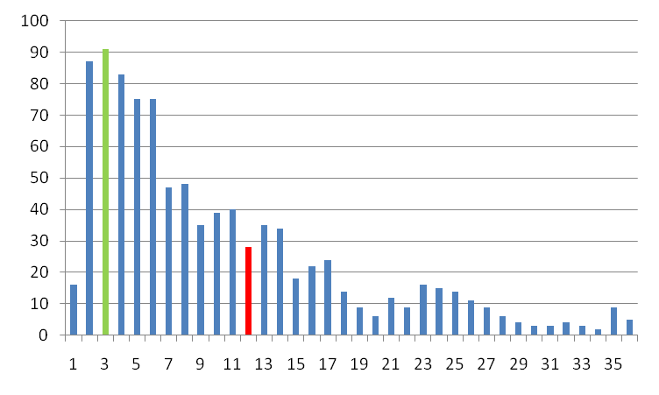
Time-to-Equilibrium Distribution
Also in this case the distribution of the number of periods the system takes to reach the equilibrium is positively skewed. The mode (green bar) is around 1500 periods and the average (red bar) is around 5800 periods. Over 1000 simulations, the system took at most 50000 periods to reach the equilibrium.
Note that all the times are about ¼ of those with the Circle neighborhood.

Slide 22
Conclusions
To reach a perfect equilibrium where all the agents go 60% of the time is a difficult endeavor in the El Farol bar problem: it takes many periods for a population of 100 agents to reach the socially optimal equilibrium.
However, the simulations show that this equilibrium can be reached and that there are some conditions that facilitate the coordination among the agents. These conditions are:
  Local Information. The agents have to take their decisions on the basis of local information (i.e. their neighbor past attendances). Global information does not allow to reach the perfect equilibrium because it causes herd behavior.
  Social preferences: the agents need to have a preference for an equal attendance. If the agents are indifferent to whether they go less than their neighbor then the system will very quickly converge to an equilibrium where 60% of agents always go and 40% never go.
  Social network. Simulations show that there are some king of neighborhood that process the information more efficiently, allowing the system to reach the socially optimal equilibrium much faster than others.

