Slide 1
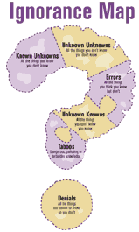
Risk, uncertainty and ignorance
Richard Zeckhauser
Harvard University
Presentation to National Chengchi University
January 2014

Slide 2
Central Arguments
The world is much more uncertain than we recognize.
Individuals are poor at making decisions under uncertainty.
Economists have recognized distinction between risk and uncertainty.
Ignorance is a critical additional category.
IGNORANCE – Even the potential states of the world are unknown.
Practice improves decision performance.
Awareness of problems improves decision performance.

Slide 3
Second talk will be on the Wisdom of Crowds and the Stupidity of Herds
Central Argument
Group decision making can magnify not diminish the challenges of effective decision making.

Slide 4
Importance
Behavioral decision
  Most important development in economics in two decades
  Daniel Kahneman, psychologist, Nobel Prize in Economics
Behavioral finance
  Robert Shiller, Case-Shiller Index, Nobel Prize in Economics 2013

Slide 5
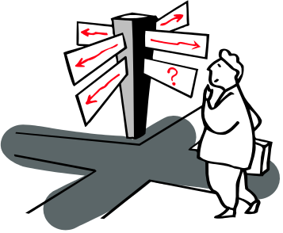
Founders of the Field (Nobel Prize winners)
  Amos Tversky and Daniel Kahneman
    “Judgment Under Uncertainty,” Science, 185 (1974): 1124-1131
    “Prospect Theory,” Econometrica, 47 (1979): 263-291
  Thomas Schelling
    The Strategy of Conflict – interactive decisions, drawing inferences from actions of others
  Kahneman, Thinking, Fast and Slow (2011)

Slide 6
Register Your Clickers
I am an A
I am a B

Slide 7

Shock Experiment:
Amount I would need to get paid
$0
$1-9
$10-24
$25-99
$100-499
$500-999
$1000-4,999
$5,000-9,999
$10,000 or more

Slide 9
Update Information
Gather information and update appropriately
Be sensitive to the value of perfect and
imperfect information
        − Operation for mother

Slide 10



Anchoring
Reddish or Blackish Bag Problem
1/2
1/2
RBRRBRBRRBR 7R 4B

Slide 11
What is the likelihood that this is the REDDISH Bag?
Less than 50%
50-60%
60-70%
70-80%
80-90%
90-95%
More than 95%

Slide 12
Categorization of Situations Where Outcomes are Unknown
States of the World
Known
Unknown
Known
Risk
NA
Probabilities
Unknown
Uncertainty
Ignorance
  RISK – Las Vegas
  UNCERTAINTY – World Series victor; weather; bin Laden in Abbotabad.
  IGNORANCE – What will happen in Syria. Financial catastrophes next decade. Consequences of climate change.

Slide 13
Main Arguments
Many important public policy problems are characterized by Ignorance.
Human beings are poor at recognizing Ignorance.
When Ignorance is recognized, human beings are poor at making decisions.
Poor decision making under Ignorance reflects brain function optimized for other realms.
RJZ is ignorant about brain function.
Public policy is even worse at making decisions than individuals when confronted with Ignorance.
  Made by individuals.
  Operating in organizations.
  Multiple parties involved in decisions.
  Strategic behavior and misaligned interests prevent information from flowing, and choices from being appropriate.

Slide 14
Behavioral decision
Certainty – A/A-
Risk – B+
Uncertainty – B-
Ignorance – C (a Harvard C)

Slide 15
Evidence that Ignorance is Not Recognized
Major policy developments/concerns of recent years not even publicly recognized one or two decades ago.
  Climate change
  NSA surveillance
  Arab Spring
  Terrorism in the U.S.
  Financial meltdown
Evidence that problems were not recognized. Look at NYTimes stories after event and before event.

Slide 16
Climate Change and Global Warming
1988 James Hansen produces report – human behavior warming the planet
1990, 1995, 2001, 2007, 2014 IPCC Reports – increasingly alarmist
NYTimes articles – Mentions out of 100,000 articles
  First six months of 2013 : 4460
  First six months of 2000
  First six months of 1990
: 40
Ratio 111
: 40

Slide 17
Major Policy Issues
Mentions out of 100,000 NYTimes articles
"terrorism"
  First six months of 2013
  First six months of 2001
“government surveillance”
  6/11/13 - 9/11/13
  Last three months of 2012
“financial crisis United States”
  First six months of 2013
  First six months of 2006
: 820
Ratio 3
: 280
: 120
Ratio 12
: 10
: 1620
Ratio 12
: 140

Slide 18
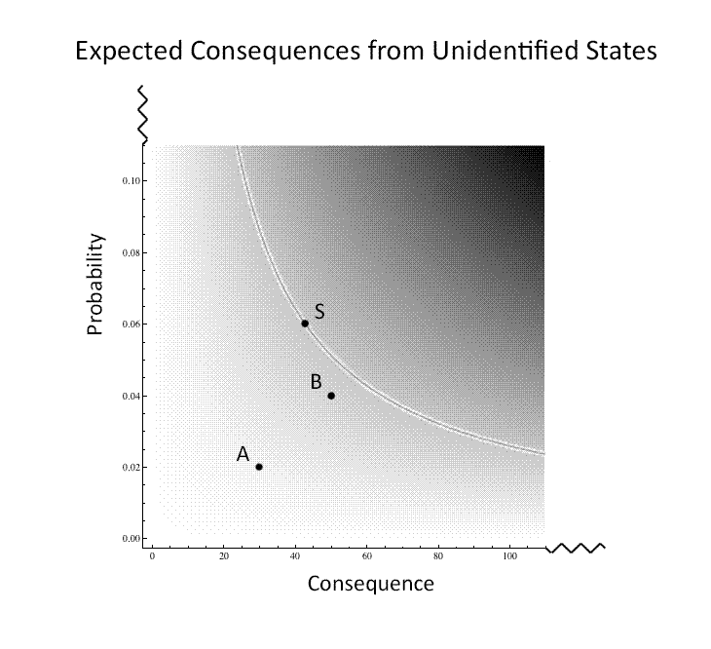
Consequential Amazing Developments (CADs)

Slide 19

Sherlock Holmes –
Greatest Detective in Western Literature
"In solving a problem of this sort, the grand thing is to be able to reason backwards. That is a very useful accomplishment and a very easy one, but people do not practice it much. In the everyday affair of life, it is more useful to reason forwards, and so the other comes to be neglected. There are 50 who can reason synthetically for 1 who can reason analytically."
"Most people, if you describe a train of events to them, will tell you what the result would be. They can put those events together in their minds, and argue from them that something will come to pass. There are few people, however, who if you told them a result, would be able to evolve from their own inner consciousness what the steps were that led up to that result. This power is what I mean when I talk of reasoning backwards, or analytically."
From A Study in Scarlet

Slide 20
Would Holmes’ Skill Conquer Ignorance?
What are major problems with Ignorance?
Failure of Recognition.
Weakness in Anticipating CADs.
Dealing with Ignorance requires a different mindset.

Slide 21
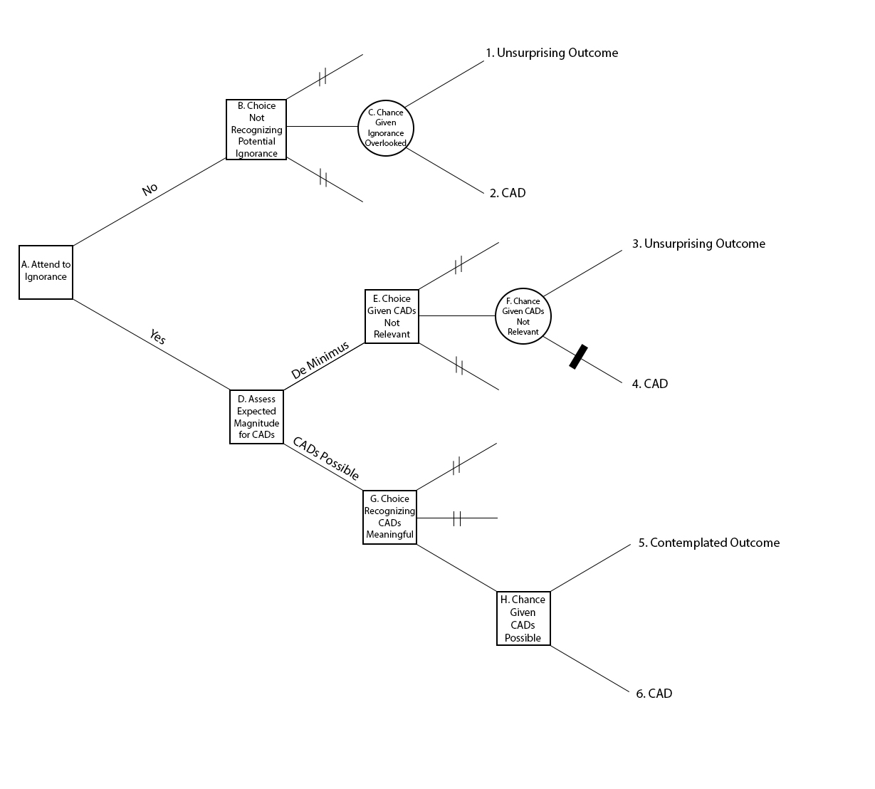
Decisions Under Ignorance

Slide 22
Poor Decisions Given Ignorance
Not contemplating magnitude of CADs – Ignorance not recognized
Ignorance recognized
  Action bias – anticipate favorable CADs
  Status Quo bias – anticipate unfavorable CADs
  Indecision bias
Focus on Ignorance not recognized
Experiments in laboratory not feasible to study many aspects of Ignorance
  “Ignorance: Lessons from the Laboratory of Literature,” with Devjani Roy

Slide 23
Ignorance Not Recognized: Possibly Related Psychological Findings
Inattentional or perceptual blindness – gorilla and basketball experiment
Miller’s Law – Can hold 7 objects in working memory
Failures of multi-tasking – limited-capacity, single-channel theories
Cognitive bottlenecks – e.g., ½ second to identify and consolidate a visual stimulus in visual short-term memory

Slide 24
The Brain as an Economizing Organ
Robots and computer-aided decision focus on particular tasks.
The brain has to be much more adaptable.
CONJECTURE: A generally efficient strategy when you have a certain quantity of assessing/reasoning/decision making power is to have it directed to the specific purpose of the moment.
*At times, of course, this heuristic behavior proves inferior.
  For example, we do not see the gorilla.
  We have trouble entertaining multiple hypotheses.
    Polarization
    Physician, one diagnosis and therapy. Doesn’t work. Second diagnosis and therapy.
CONJECTURE: The brain is not used to (good at) entertaining developments that would amaze that have not been experienced before. (Opposite of the availability heuristic.)
  Shark attacks – readily available
  NSA surveillance, financial meltdown – highly unavailable

Slide 25
Closing Conundrum
The brain has difficulty focusing on multiple subjects or stimuli at the same time. That is efficient, and can be thought of as how one would use a super computer.
Individuals fail to recognize despite having long time periods to switch from one focus to another. Why?
Government organizations, which have highly trained individuals with a responsibility to anticipate CADs, often fail in the same way.

Slide 26
