Slide 1
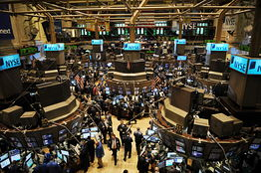
The Wisdom of crowds and stupidity of herds
Richard Zeckhauser
Harvard University
Presentation to National Chengchi University
January 2014

Slide 2
Goal of this Presentation
Engage you in active decision making
Many questions already at your place
Focus on group decisions

Slide 3
Rational Analysis
Probabilities are critical
Subjective probability
Bayesian analysis
Choices depend on payoffs and probabilities
  NOT on Framing or Source of Uncertainty

Slide 4
Subjective Probability
Probability: “Subjective degree of belief in a proposition” proposed by John Maynard Keynes in the early 1920s.
Concept extended by
    Bruno de Finetti in Italy (Fondamenti Logici del Ragionamento Probabilistico, 1930) and
    Frank Ramsey in Cambridge, England (The Foundations of Mathematics, 1931)

Slide 5
Assigning Subjective Probabilities
Worry about distributions, not just mean values
Estimation task
Know what you know, and you do not know

Slide 6
Filling in Boxes
Best guess – A number you think the true value is equally likely to be above or below.
1% surprise point – A number you think it is only one chance in 100 that the true value is below.
99% surprise point – A number you think it is only one chance in 100 that the true value is above.

Slide 7

Significant Focus Now will be on Group Decision Processes
Most important decisions in most organizations are made through a group process.
Frequently there is a discussion followed by consensus decision making.
Group decisions can magnify individual behavioral biases.
What can we do to:
  Get the benefit of the collective wisdom and judgment of the group?
  While avoiding the biases that afflict group decision making?

Slide 8
Group Decisions
Differences in Probabilities
 | No | Yes
No
Yes
Differences in Preferences
A. Simple Problem
B. Syndicate Problem
C. Arrow’s Problem
D. Big Challenge
Box D, Big Challenge, is where most group decisions land.

Slide 9
Group Decision
Behavioral Decision
Group Processes
Interaction of Behavioral Decision and Group Processes

Slide 10
Behavioral Aspects of Group Decision Processes
Group processes exacerbate behavioral propensities.
  Agreement on why your candidate will win.
  Reinforcing beliefs on why the business deal makes sense.
  Herding suppresses information.
Guess the predominant color.
Implication: Encourage alternative models and contrary evidence.

Slide 11
The Wisdom of Crowds and the Stupidity of Herds
POSITIVE: On any question in this room, individuals have knowledge. If we could capture that knowledge effectively, we could make superior decisions.
Central tendencies
Crowd sourcing – what products to produce
NEGATIVES:
Many aggregation methods throw away information. The Slips Experiment.
Information may be conveyed through actions, and those actions can be costly.
- Civil unrest, e.g., the Arab Spring.
Information aggregation gets mixed in with other motives.
PERSONAL REWARD: Should the School of Information Science and Engineering develop a joint masters program with the School of Economics? Those most knowledgeable about prospects will have a personal interest in the outcome.
APPEARING INTELLIGENT

Slide 12
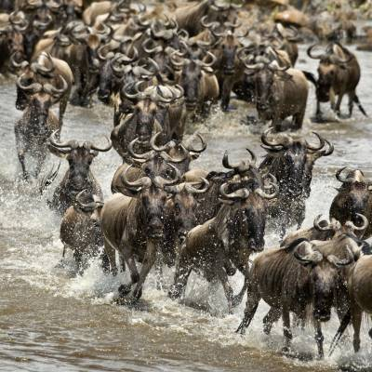
Herding – The tendency to change one’s own action or response to be closer to the mean, median, or mode of the group.
Herding to reflect information gained.
Herding so as not to stand out.
  Political correctness.
  Appearance of being knowledgeable.
  When preferences and probabilities are involved. To assure loyalty (similar preferences).

Slide 13
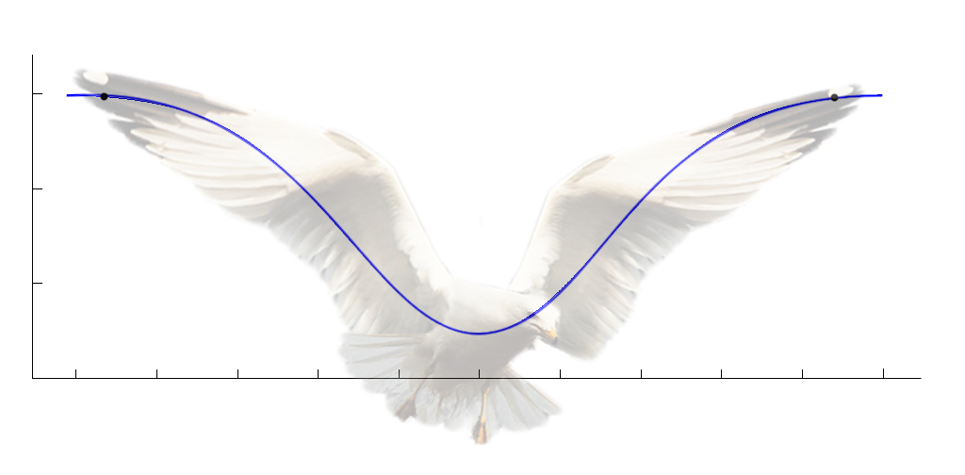
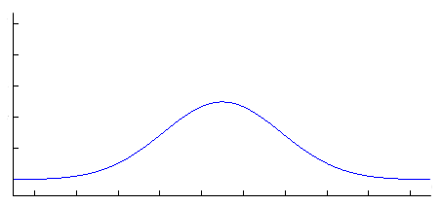
THE FAT SEAGULL— The Current Salience of Behavioral Finance
100%
Stock Market
February 2009
Housing 2007
Panic
Euphoria
Psychological
versus
Value Pricing
•
Financial Assets
January 2014
Financial Assets
November 2012
•
0%
Low
1
High
Price/Value Ratio Relative to History or Recent Norms
Frequency
Fat-Tailed Distribution
Price/Value Ratio

Slide 14
Herding can:
Be individually rational but collectively irrational
Suppress the revelation of information
Randomly push the group to an inferior equilibrium
Make it difficult to get a sense for a group’s true preferences

Slide 15
Availability Heuristic
(Difficult to recall all valid cases, whether vivid or not, from past)
  Frequency of event approximated by availability of its instances.
  Incorrect estimation of associations because recall of only selective combinations.
  Ex. Martin is analytic, regularly reads the Wall St. Journal, and invests his personal portfolio in a well-diversified portfolio of value stocks.
  What are the odds that Martin is a finance professor teaching MBAs as opposed to being a physician?

Slide 16
Only A’s Vote:
What is the likelihood that he is in each profession?
More than 90% that he is a finance professor teaching MBAs
70-90% that he is a finance professor teaching MBAs
51-70% that he is a finance professor teaching MBAs
50% that he is in either profession
51-70% that he is a physician
70-90% that he is a physician
More than 90% that he is a physician.

Slide 17
B’s: Please answer with clickers
You have and will learn a variety of psychological principles and tools in these two lectures. Will you use these principles and tools to get your colleagues to agree to policies that are quite different than the ones that they would have agreed to if you did not use them?
  YES
  NO

Slide 18
A’s: Please answer with clickers
You are in the process of selling your car to a person you met via the Internet. He has inspected the car, and has agreed to come by to pick it up this afternoon in exchange for $8,000.
You drove the car this morning and discovered that it had trouble starting. This is a mechanical problem that can be fixed for roughly $800.
This info is not known to the buyer and will not be known until the sale has been completed and he has driven away (at which point the buyer will have paid and cannot do anything legal or otherwise to reverse the sale).
Would you reveal this info to the buyer before the sale is made?
  YES
  NO

Slide 19
B’s: Please answer with clickers
The population of Turkey is more than 100 million people.
  YES
  NO

Slide 20
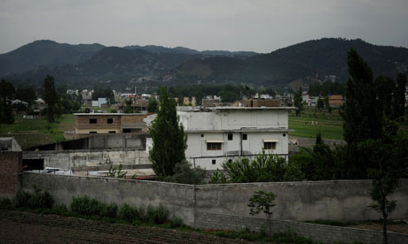
Zero Dark Thirty and Self Absorption
President Obama had assembled a skeptical team. It said 40% likely.
The agent in charge of the search (played by Jessica Chastain in the movie) said 95% likely.
They had access to same information. Yet, they were much more influenced by what they had gathered themselves.
Bin Laden’s Lair?

Slide 21
Discounting the Information of Others
Availability bias
  British Airways lost your luggage on a recent trip.
  You swear never to fly British Airways again. You actually abstain for a year. But your colleague, who believes you, is only marginally influenced.
Hidden Agenda Heuristic
  Across a wide array of situations, others are providing you information to influence a decision in their direction. For example: prospective employee or salesmen.
  Thus, you come to believe you should trust your own information more than that from others.
  You employ this heuristic even when interests are fully aligned.

Slide 22


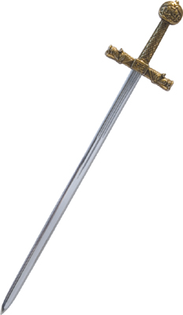
Conclusions
Individuals fall prey to significant behavioral propensities when making decisions.
These propensities are most salient when probabilities and/or significant negative payoffs are involved.
Group processes, quite apart from behavioral propensities, frequently do a poor job of capitalizing on the available information.
Group processes often compound behavioral propensities.
Group decision is a double-edged sword.
⇒ ???

