Slide 1
Herbert Simon Lecture Series: Series 28
Hayek, Sensory Order and Methodological Individualism
Prof Francesco Di Iorio
Department of Public Administration
School of Humanities
Southeast University

Slide 2
CV Highlights
2012: PhD in Philosophy at École des Hautes Études en Sciences Sociales (School for Advanced Studies in the Social Sciences)
2013 (Juanuary/July – 7 months): Postdocoral Research Fellow, Duke University (Center for the History of Political Economy), USA (post‑doc supervisor: Bruce Caldwell).
2014‑2015: Adjunct Professor (Philosophy of Social Science), LUISS University, Rome, Italy

Slide 3


Slide 4
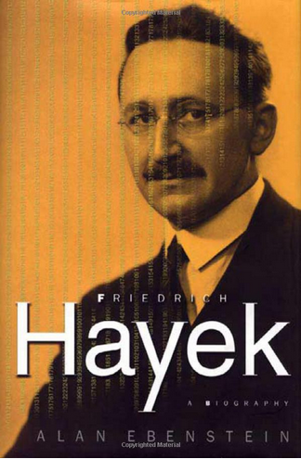
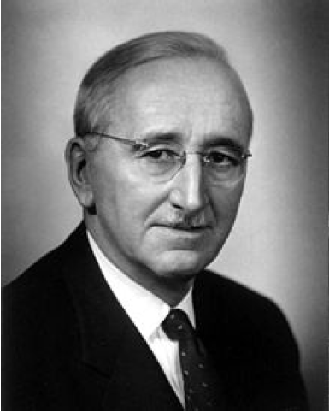

Slide 5
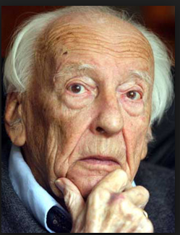
Hans-Georg Gadamer (1900-2002)

Slide 6
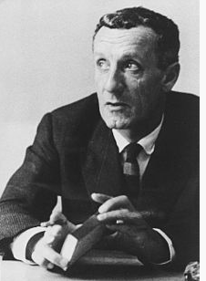
Maurice Merleau-Ponty (1908-1961)

Slide 7
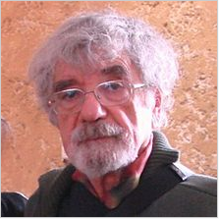
Humberto Maturana

Slide 8
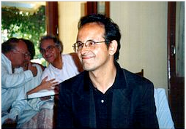
Francisco Varela (1946-2001)

Slide 9
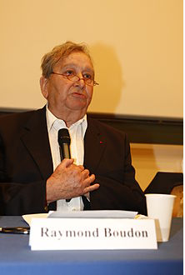
Raymond Boudon (1934-2013)

Slide 10
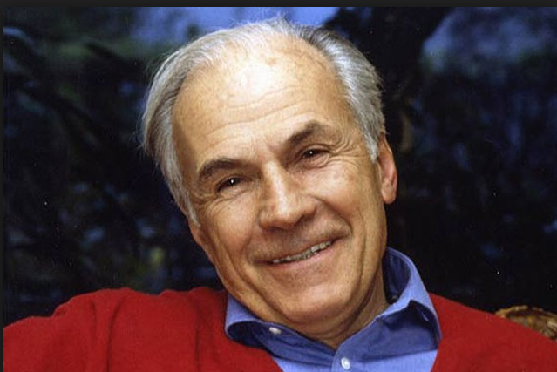
Michel Crozier (1922-2013)

Slide 11
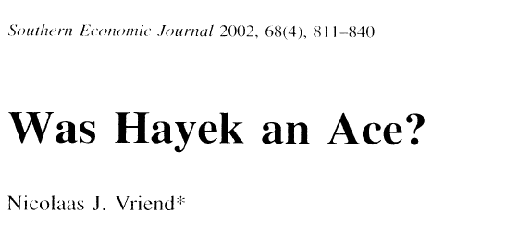
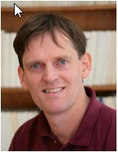

Slide 12
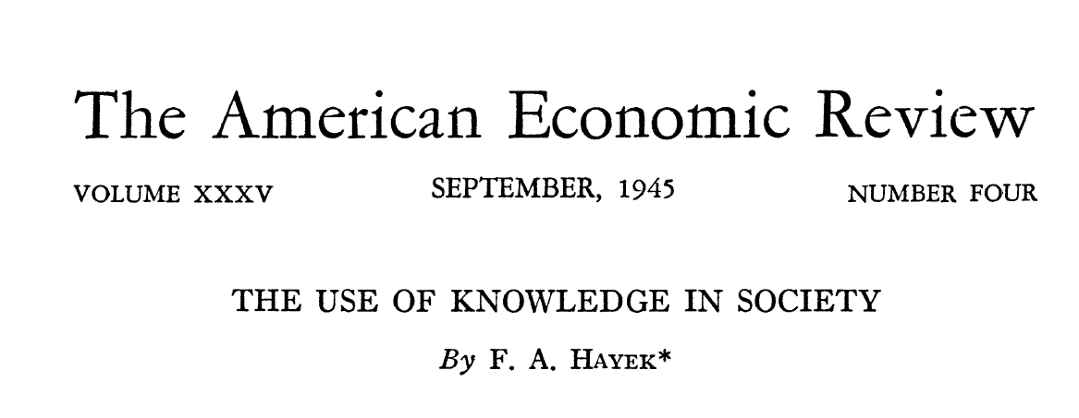
Hayek and Hayek (1945)

Slide 13
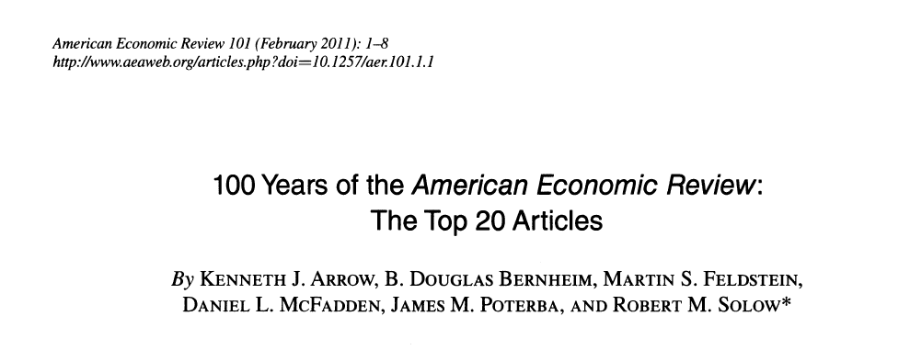

Slide 14
Two Lectures
Lecture I
  Hayek as a Methodological Individualist
Lecture II
  Sensory Order and Methodological Individualism

Slide 15
Hayek as a Methodological Individualist
  Chapter 4: Human Autonomy and Social Systems

Slide 16
Sensory Order and Methodological Individualism
  Chapter 2: The Interpretative Nature of Knowledge: Hermeneutics and Sensory Order
  Chapter 3: From Cognitive Autonomy to the Criticism of Socio-cultural Determinism

